Slide 1
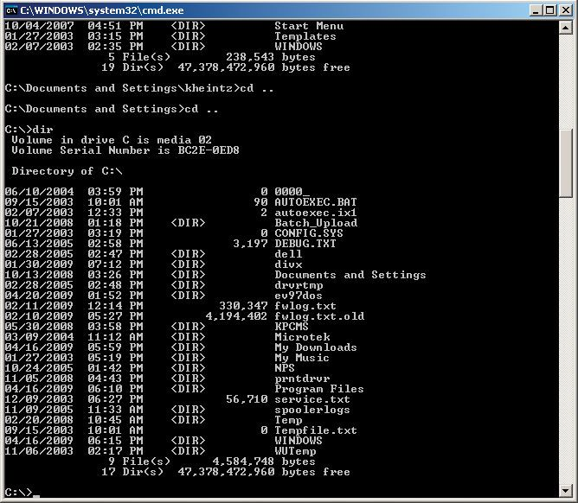

MS-DOS Microsoft Disk Operating System

Slide 2
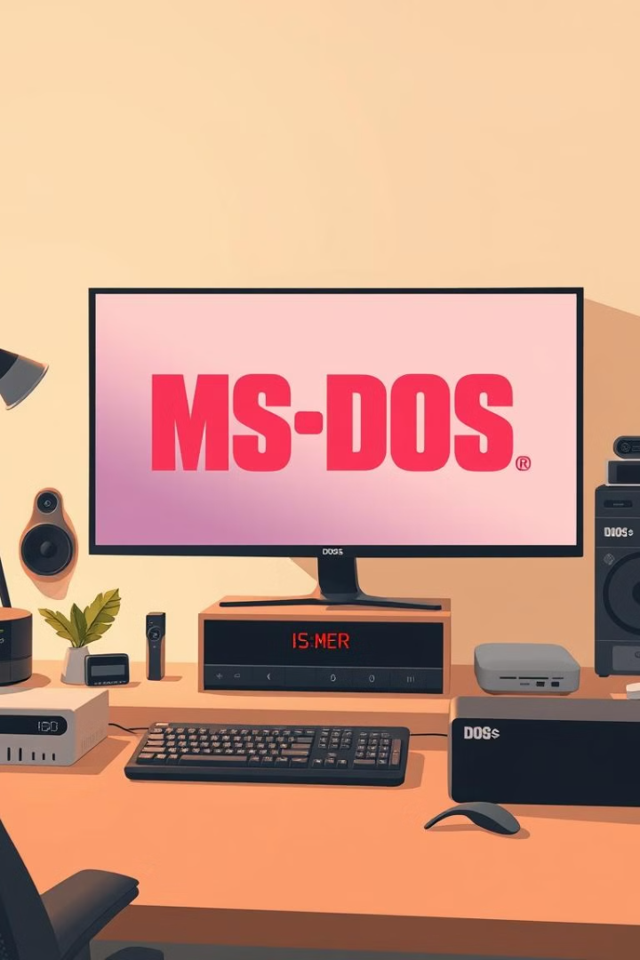
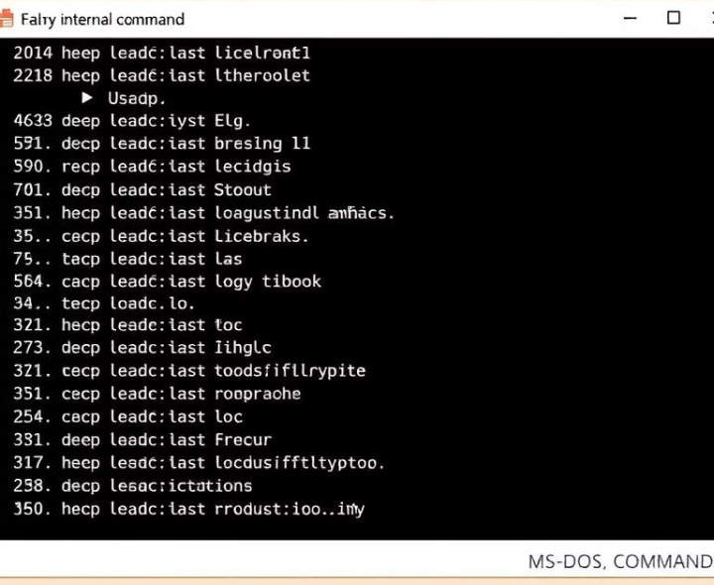
Content
Introduction
History of MS-DOS
Features and multiple versions of MS-DOS
MS-DOS Layer Structure
Key features of MS-DOS
Basic MS-DOS Commands
Conclusion

Slide 3
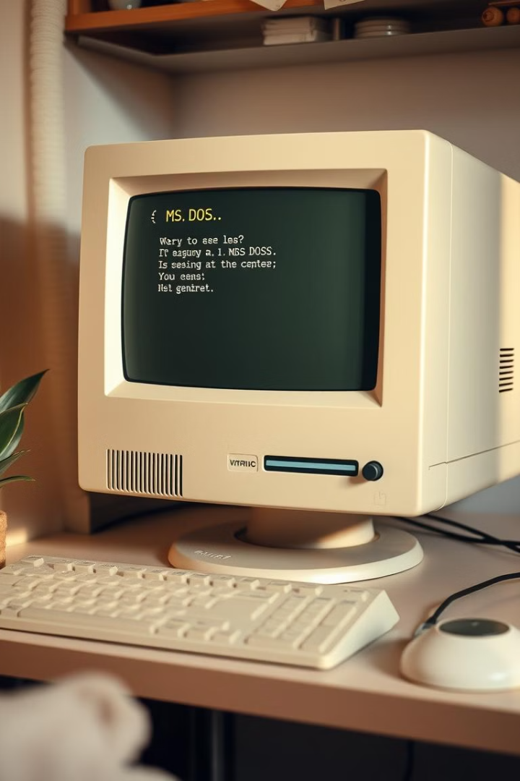
Introduction
MS-DOS (Microsoft disk operating system) is a command-line-based operating system . It was primarily developed in assembly language for its core components. It was created by Microsoft and played a foundational role in the development of personal computers.

Slide 4
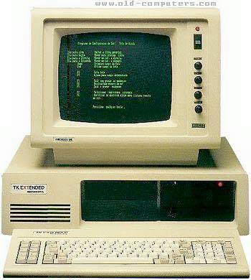
History of MS-DOS
MS-DOS was initially created as 86-DOS by Seattle Computer Products. Microsoft acquired the rights in 1981, rebranding it as MS-DOS. Launched in 1981, MS-DOS became the primary operating system for IBM PCs.

Slide 5
Microsoft continued to develop and improve MS-DOS , adding features and multiple versions.
MS-DOS 2.0 (1983) – introduced support for hard drivers and directories , significantly expending the OS’s capabilities.
MS-DOS 3.x Series (1984-1986) – added support for larger hard drives, network and new hardware (floppy drivers)
MS-DOS 4.0 (1988) – introduce a graphical shell.
MS-DOS 5.0 (1991)– improved shell, better memory management and the inclusion of the BASIC interpreter QBASIC.
MS-DOS 60x series (1993-1994) – include disk compression (Double space), better file utilities and a defragmenter.

Slide 6
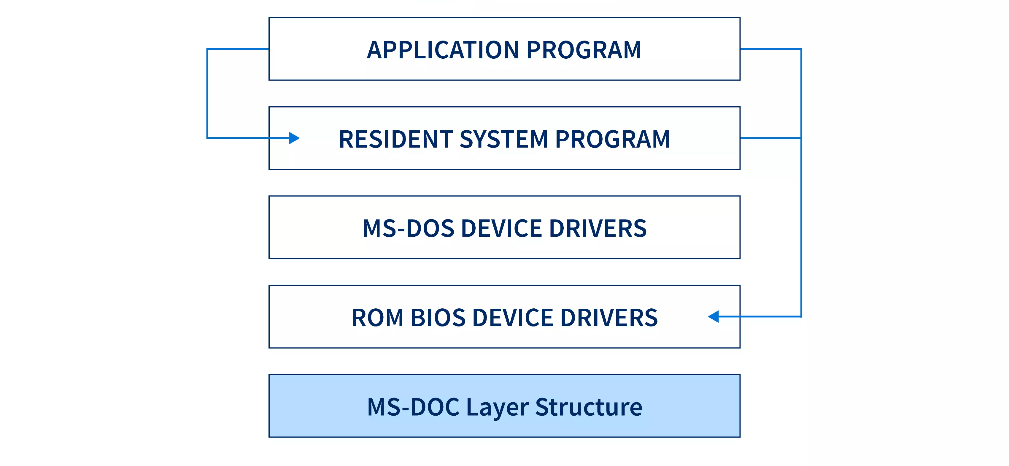
MS-DOS Layer Structure

Slide 7
Key features of MS-DOS
Command line interface (CLI):- users interacted with the system through text commands type at a prompt rather than using a graphical interface.
File Management(FAT):- File name followed an 8.3 format-8 characters for the name , followed by a 3-character extension. This was due to limitations of the FAT file exited.
Single-Tasking:- Early system were design to run one program at a time, so multitasking wasn’t possible.
Direct Hardware Control:- Users and developers had direct access to system hardware, which allowed for greater control but could lead to stability issues or conflicts.

Slide 8
Basic MS-DOS Commands
File and Directory Commands
System and Disk Commands
Other Useful Commands
DIR
CD
MD
DEL
COPY
FORMAT
CHKDSK
DATE and TIME
RENAME or REN
CLS
EXIT
PROMPT

Slide 9

Conclusion
MS-DOS was a game-changer in personal computing , providing the structure that allowed PC s to take off. Although technology has moved on , it’s impact remains, especially is the way we still use command line interfaces and understand file system . learning about MS-DOS gives us a great look into the early days of software and how we arrived at today’s advanced system .

Slide 10
B: \ class \ audience > Thank you !

